Slide 1
OKCupid Data Analysis
Machine Learning Fundamentals
Pete Andersen
11/1/2018

Slide 2

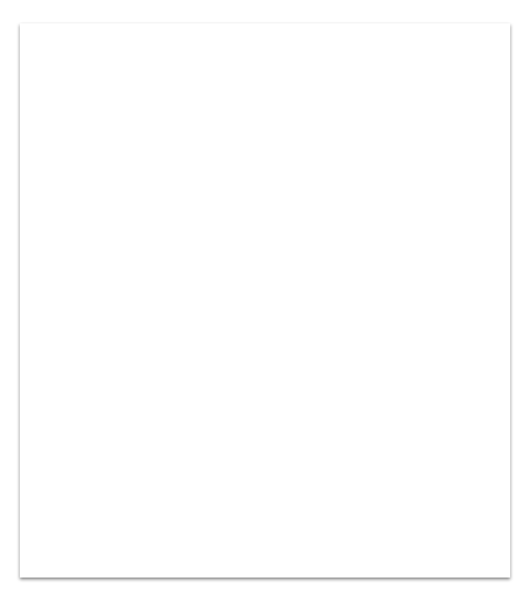
Table of Contents
Question to Answer
Exploration of the Dataset
Augmenting the Dataset
Classification Approaches
Regression Approaches
Conclusions/Next steps

Slide 3
Question to Answer?
Can we uses this data to predict the likelihood they will do drugs?
Smokes
Drinks
Sex

Slide 4
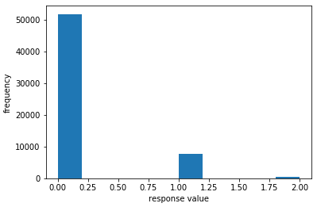
Exploring the Dataset- Drugs
Drug Use Frequency ￼
￼￼Key
Never = 51804
Sometimes = 7732
Often = 410

Slide 5
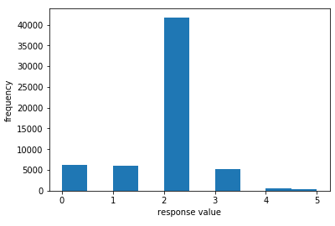
Exploring the Dataset- Drinks
Drinking Frequency
Key
Not at all = 6252
Rarely = 5957
Socially = 41780
Often = 5164
Very Often = 471
Desperately = 322

Slide 6
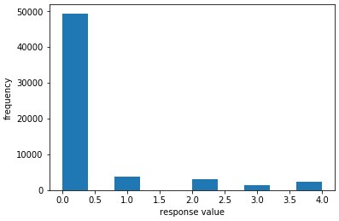
Exploring the Dataset- Smokes
Smoking Frequency
Key
No= 49408
Sometimes = 3787
When drinking = 3040
Trying to quit = 1480
Yes = 2231

Slide 7
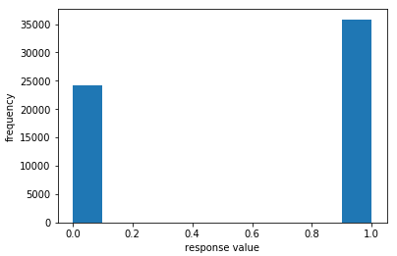
Exploring the Dataset- Sex
Key
Male = 24117
Female = 35829

Slide 8
New Columns
I created four new columns smokes_code, drugs_code, drinks_code, sex_code by mapping them from their textual responses to integer values with less likely values starting with zero and rising

Slide 9
New Columns
smokes_mapping = {"no": 0, "sometimes": 1, "when drinking": 2, "trying to quit": 3, "yes": 4}
df["smokes_code"] = df.smokes.map(smokes_mapping)
drugs_mapping = {"never": 0, "sometimes": 1, "often": 2}
df["drugs_code"] = df.drugs.map(drugs_mapping)
drinks_mapping = {"not at all": 0, "rarely": 1, "socially": 2, "often": 3, "very often": 4, "desperately": 5}
df["drinks_code"] = df.drinks.map(drinks_mapping)
sex_mapping = {"f": 0, "m": 1}
df["sex_code"] = df.sex.map(sex_mapping)

Slide 10
Classification Comparisons
Naive Bayes Classifier versus K-Nearest Neighbors Classification
I actually found these two options much more simple to implement then both of my regression models I used. Both of these were very similar to implement, I pretty much just had to swap, which kind of classifier I was using and I already had the columns created, because I worked on the regression piece first for the same question. I heavily utilized the SKLearn functions. It was interesting to be able to compare the results of both against the same data sets. I also modified the drugs_code mapping to the following so it would be binary - drugs_mapping = {"never": 0, "sometimes": 1, "often": 1} (so either you don’t or you do)

Slide 11
Naive Bayes Classifier
The approach I took for this classifier was two use three new columns I had created called drinks_code, smokes_code, and drugs_code, which I used numpy to remove NaN values from. For the X values I used drinks_code and smokes_code, whereas the y values I used drugs_code. I then looked at probabilities of certain scenarios and tested out predictions.
Time to Run: 0:00:00.052998
Accuracy: 0.8488418730572546
Recall: 0.14291003332099222
Precision: 0.35543278084714547
F1_Score: 0.20385529442830738
Example probability for [[4,2]] (drinks very often, smokes when drinking):
[[0.7604375 0.2395625]]

Slide 12
K-Nearest Neighbors Classifier
The approach I took for this was almost identical to the approach for Naive Bayes Classifier besides for the fact that I was using KNeighborsClassifier instead. I ran it through the same data, and the same tests simultaneously so I could compare results except for the F1 score.
Time to Run: 0:00:03.720889
Accuracy: 0.8149002306226812
Recall: 0.34690855238800444
Precision: 0.32705061082024434
Example probability for [[4,2]] (drinks very often, smokes when drinking):
[[0.7604375 0.2395625]]

Slide 13
Regression Comparisons
Linear Regression versus Multiple Linear Regression
I decided to compare the difference between trying to answer this question comparing the results of a linear regression strictly using drinking to try and predict drug use and multiple linear regression using drinking, smoking, and ended up adding in sex to see if it would make a difference. For both comparison I split the test data into a larger training segment, and smaller test segment

Slide 14
Linear Regression
The approach of drug use vs drinking habits was fairly straightforward and simple. From a quality standpoint I had to remove the NaN values after putting them into new columns. I feel this test could have been more reliable if I had data on drinks per week etc…
Time to Run: 0:00:00.210979
Coefficients: [0.08194646]
Mean squared error: 0.13
Variance score: 0.04
It did indeed seem to show that the more someone drinks the more susceptible they are to partake in drug use

Slide 15
Multiple Linear Regression
The approach of drug use vs drinking habits was fairly straightforward and simple. I again had to remove the NaN values after putting them into new columns. Including smoking into this definitely increased the accuracy, and sex made small differences to predictions, but nothing major I feel this test could have been more reliable if I had data on drinks per week etc…
Without Sex-
Time to Run: 0:00:00.839959
Coefficients: [0.0656487 (drinks), 0.09656577 (smokes)]
Mean squared error: 0.12 (no change)
Variance score: 0.10 (no change)
It did indeed seem to show that the more someone drinks the more susceptible they are to partake in drug use

Slide 16
Multiple Linear Regression
With Sex-
Time to Run: 0:00:01.094968
Coefficients: [0.06576174 (drinks), 0.09596433 (smokes), 0.02938295 (sex)]
Mean squared error: 0.12
Variance score: 0.10
Influence on Predictions predict score example-
Input = drinks very often, smokes sometimes, and female
Result = [0.32770858]
Input = drinks very often, smokes sometimes, and male
Result = [0.35709153]
Input = drinks very often, smokes sometimes without sex added
Result = [0.34504702]

Slide 17
Conclusion
Was my question answered? I think with the data available you could somewhat predict if someone was more likely to drugs, but not an accuracy level I would be comfortable with.
Next Steps-
I think you would have to get data from a more confidential source, I would make the assumption that not everyone would even answer that question accurately on a dating website, possibly even the drinking/smoking questions as well
Gather different data- This data obviously was not setup to answer the question I was looking at, it just looked interesting
In order to get a better answer I think you could look at a few other fields
Number of times per week someone drinks, number of drinks they have when they do, hard alcohol vs beer
What are people smoking and how often
Other thoughts
I definitely feel the smoking factor played a bigger role in being accurate then the drinking portion
It seemed there was also a higher chance for men in the linear regression testing I was doing

